Slide 1

Department of CSE
Course: AI & ML
Course code: 24AD2001A
Topic:
Probabilistic Models: Gaussian Naive Bayes
Session – 27

Slide 2



AIM OF THE SESSION
The aim of this session is to introduce the fundamentals of probabilistic modeling with a focus on the Gaussian Naive Bayes classifier, enabling learners to understand its underlying assumptions, mathematical formulation, and practical applications in classification tasks involving continuous data.
INSTRUCTIONAL OBJECTIVES
This session is designed to:
1. Explain the concept of probabilistic classification and Bayes’ theorem.
2. Describe the Naive Bayes assumption of conditional independence between features.
3. Differentiate between Gaussian, Multinomial, and Bernoulli Naive Bayes models.
LEARNING OUTCOMES
At the end of this session, you should be able to:
1Define the principles of probabilistic classification and Bayes’ theorem.
2. Interpret the independence assumption in Naive Bayes and its impact on model performance.

Slide 3
Objectives
1. To introduce the concept of probabilistic modeling in machine learning.
2. To understand the application of Bayes’ theorem in classification problems.
3. To explain the Naive Bayes assumption of conditional independence of features.

Slide 4
Naïve Bayes
Naïve Bayes is a probabilistic algorithm that is based on the concept of conditional probability. We know it not only for its simplicity but also for its speed. We also defined it as an algorithm is a simple and fast machine learning algorithm that is often favored in cases of real-time predictions.
What is probability?
It refers to the possibilities or likelihood of an event occurring as a probability.
P(A/B) is the conditional probability of A given B, or the likelihood of event A if event B has already occurred. Because we already know that B has happened when we experiment, the number of alternative outcomes for the event has been limited. As a result, given that B has already occurred, the unconditional probability has now changed to a conditional probability. We define the conditional probability as:
𝑃(𝐴/𝐵) = 𝑃(𝐴 ∩ 𝐵) 𝑃(𝐵)
Where 𝑃(𝐴 ∩ 𝐵) represents the joint probability, i.e. probability, of both events happening together.

Slide 5
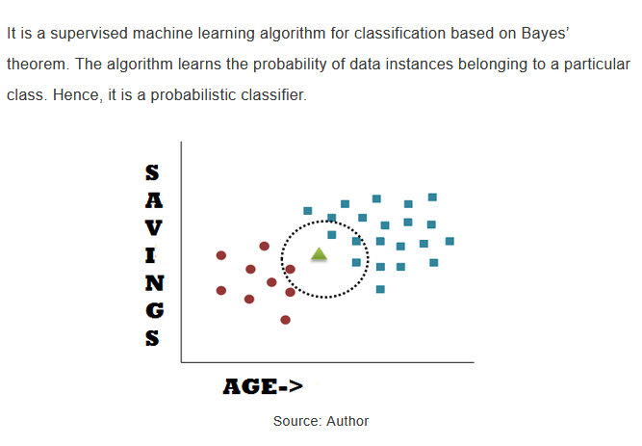
Naïve Bayes CLASSIFIER

Slide 6
Types of Naïve Bayes
There are three main types of Naïve Bayes which are listed below:
1. Gaussian Naïve Bayes
2. Multinomial Naïve Bayes
3. Bernoulli Naïve Bayes
Gaussian Naïve Bayes algorithm
In Gaussian Naïve Bayes, the assumption is made that the continuous numerical attributes are distributed normally. The attribute is first segmented based on the output class, and then the variance and mean of the attribute are calculated for each class.

Slide 7

Gaussian Naive Bayes
Gaussian Naive Bayes is a type of Naive Bayes method working on continuous attributes and the data features that follows Gaussian distribution throughout the dataset. This “naive” assumption simplifies calculations and makes the model fast and efficient. Gaussian Naive Bayes is widely used because it performs well even with small datasets and is easy to implement and interpret.
Gaussian Naive Bayes assumes that the likelihood (P(xi∣yxi​∣y)) follows the Gaussian Distribution for each xixi​ within ykyk​. Therefore,

Slide 8
CONTD..
Where:
Xi is the feature value,
μ is the mean of the feature values for a given class yk​,
σ is the standard deviation of the feature values for that class,
π is a constant (approximately 3.14159),
e is the base of the natural logarithm.
To classify each new data point x the algorithm finds out the maximum value of the posterior probability of each class and assigns the data point to that class.

Slide 9
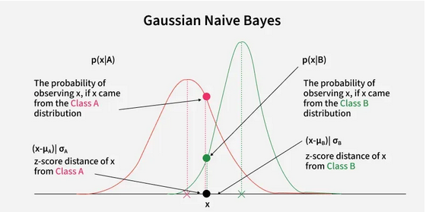
CONTD..

Slide 10
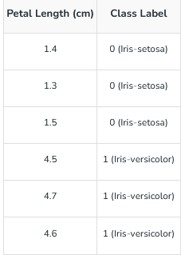
Why Gaussian Naive Bayes Works Well for Continuous Data?
Gaussian Naive Bayes is effective for continuous data because it assumes each feature follows a Gaussian (normal) distribution. When this assumption holds true the algorithm performs well. For example in tasks like spam detection, medical diagnosis or predicting house prices where features such as age, income or height fit a normal distribution there Gaussian Naive Bayes can make accurate predictions.
Practical Example
To understand how Gaussian Naive Bayes works here's a simple binary classification problem using one feature: petal length.

Slide 11
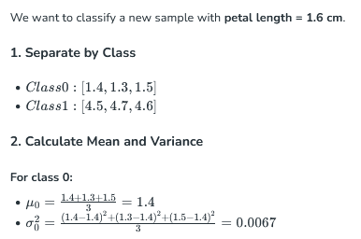
CONTD..

Slide 12
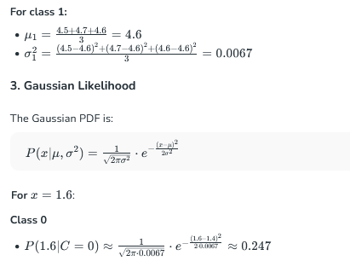
Contd..

Slide 13
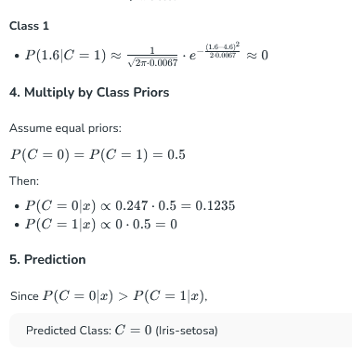
CONTD..

Slide 14
Self-Assessment Questions
1. The “Naive” assumption in Naive Bayes refers to:
Features are dependent
Features are independent given the class
Features are normally distributed
Classes have equal prior probability
Gaussian Naive Bayes is often used as a:
Deep learning replacement
Baseline classifier
Feature scaling method
Clustering algorithm

Slide 15
TERMINAL QUESTIONS
1.What is the main assumption made in Naive Bayes classifiers?
2. How does Gaussian Naive Bayes differ from Multinomial Naive Bayes?
3.Why do we use the Gaussian distribution in Gaussian Naive Bayes?

Slide 16
REFERENCES FOR FURTHER LEARNING OF THE SESSION
Books:
1. Machine Learning: A Probabilistic Perspective – Kevin P. Murphy
Excellent for understanding probabilistic foundations and Naive Bayes in depth.
2. Artificial Intelligence: A Modern Approach – Stuart Russell & Peter Norvig
Classic AI textbook, includes probabilistic reasoning and Naive Bayes as part of machine learning.
Web references:
Analytics Vidhya – Naive Bayes Classifier
https://www.analyticsvidhya.com/blog/2017/09/naive-bayes-explained/
Scikit-learn Documentation – Gaussian Naive Bayes
https://scikit-learn.org/stable/modules/naive_bayes.html

Slide 17
THANK YOU
Team – AI &ML

